Slide 1
Visual illusions

Slide 2
Intro
We will go through 11! Different visual illusions today

Slide 3
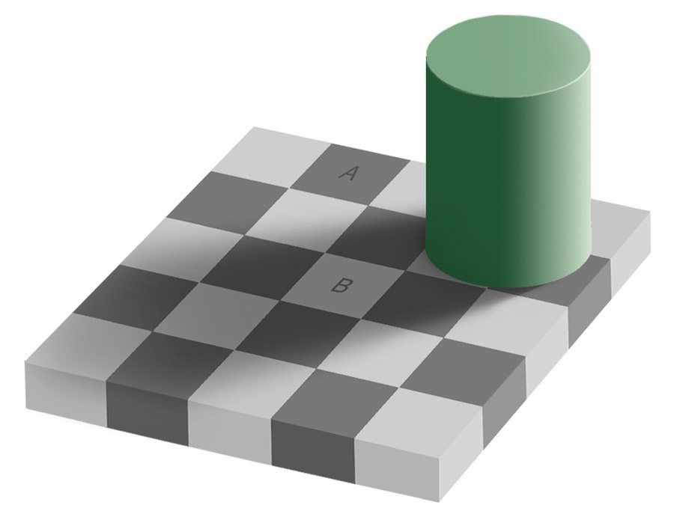
Adelson’s Checker illusion

Slide 4
Still don’t believe me? I’ll show you in real time.

Slide 5
Lilac chaser

Slide 6
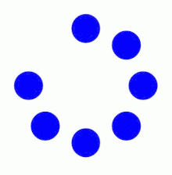
Phi Phenomenon

Slide 7
Coloured hearts illusion

Slide 8
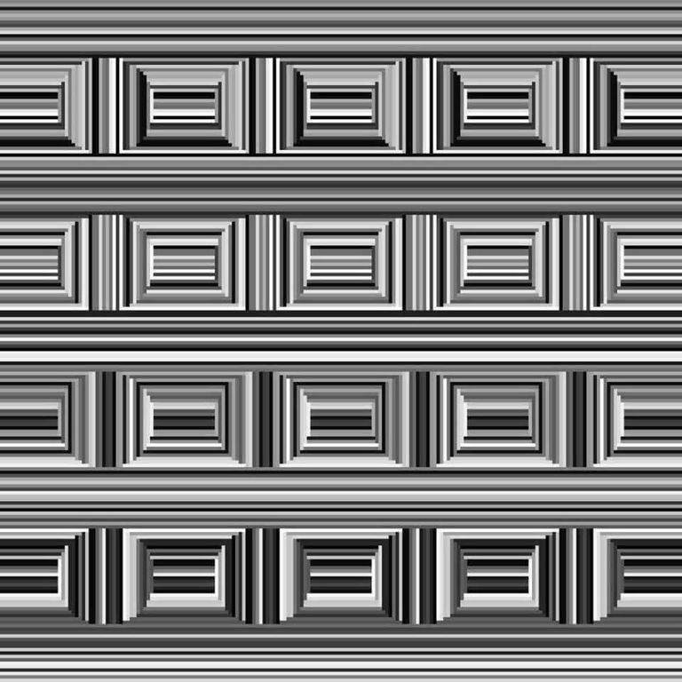
Coffer illusion

Slide 9
Dynamic luminance gradient effect

Slide 10
Dual axis illusion
https://www.youtube.com/watch?time_continue=32&v=HC0GGkNZPgs&feature=emb_logo

Slide 11
Helix Rotation
https://www.youtube.com/watch?time_continue=37&v=XKokmZvdl_g&feature=emb_logo

Slide 12
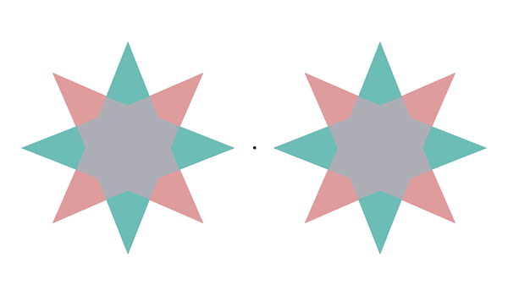
Fill in the afterimage!

Slide 13
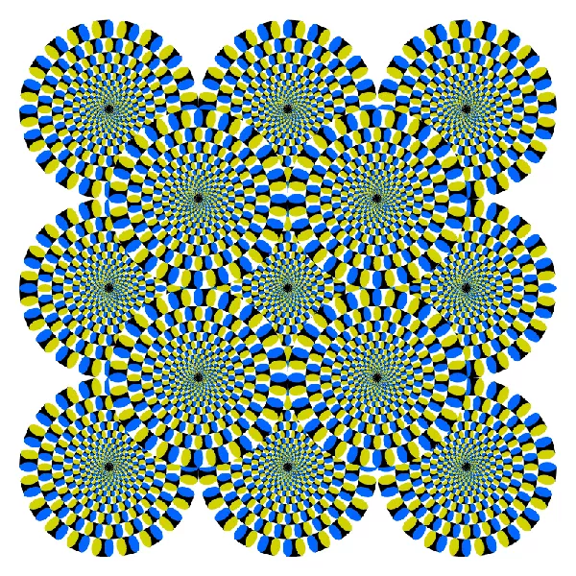
Moving circles

Slide 14
Kanizsa’s triangle

